Slide 2
The Great Mystery
“The Great Mystery” is an inspiring, uplifting and entertaining feature documentary that bridges the divisions between the 6 major religions as the movie follows one woman's fascinating, comedic, and heroic trip through western America seeking answers to universal questions; Why are we here? Who is God? Will there ever be peace?”

Slide 4
The Authority of God’s Word
“Above all, you must understand that no prophecy of Scripture came about by the prophet’s own interpretation of things. For prophecy never had its origin in the human will, but prophets, though human, spoke from God as they were carried along by the Holy Spirit.”
2 Peter 1:20-21

Slide 5
The Great Mystery
A Great Message: The scriptures are a special source of truth. (v.14)

Slide 7
What is the Church?
Imagery | Meaning
God’s Household | A Committed Family
Church of the Living God | A Dynamic Community
Pillar and Foundation of the Truth | A Faithful Witness

Slide 9
The Great Mystery
A Great Message: The scriptures are a special source of truth. (v.14)
A Great Mission: The church is a crucial bearer of the truth. (v.15)

Slide 10
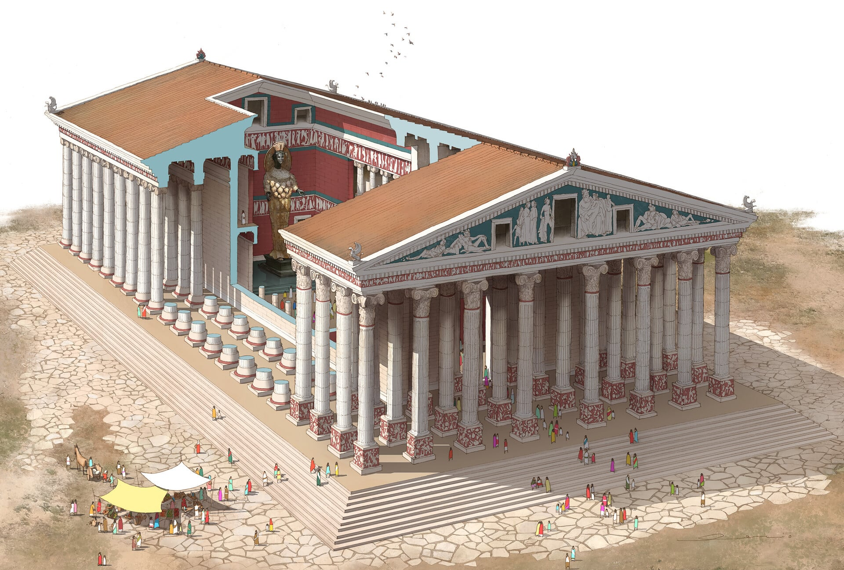
“Great is Artemis of the Ephesians!”

Slide 11
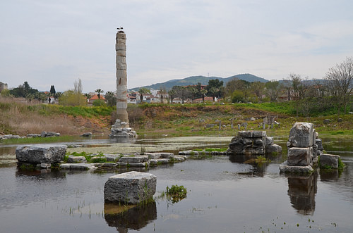
Not so Great Today!

Slide 12
Differentiating essentials
Yellow=essentials

Slide 13
License
Liberty
Legalism
Ldrs: Everyone
Ldrs: Servants
Ldrs: Bosses
Anything Goes!
Use Discernment
Total Conformity

Slide 15
Six Essential Truths | Christ Event | Contrasts
Appeared in the flesh | Incarnation | Flesh
Vindicated by the Spirit | Resurrection | Spirit
Seen by angels | Exaltation | Angels
Preached among nations | Proclamation | Humans
Believed on by the world | Redemption | World
Taken up in glory | Ascension | Heaven

Slide 16
Seen By Angels
“It was revealed to them (Old Testament prophets) that they were not serving themselves but you, when they spoke of the things that have now been told you by those who have preached the gospel to you by the Holy Spirit sent from heaven. Even angels long to look into these things.”
1 Peter 1:12

Slide 17
Six Essential Truths | Christ Event | Contrasts
Appeared in the flesh | Incarnation | Flesh
Vindicated by the Spirit | Resurrection | Spirit
Seen by angels | Exaltation | Angels
Preached among nations | Proclamation | Humans
Believed on by the world | Redemption | World
Taken up in glory | Ascension | Heaven

Slide 18
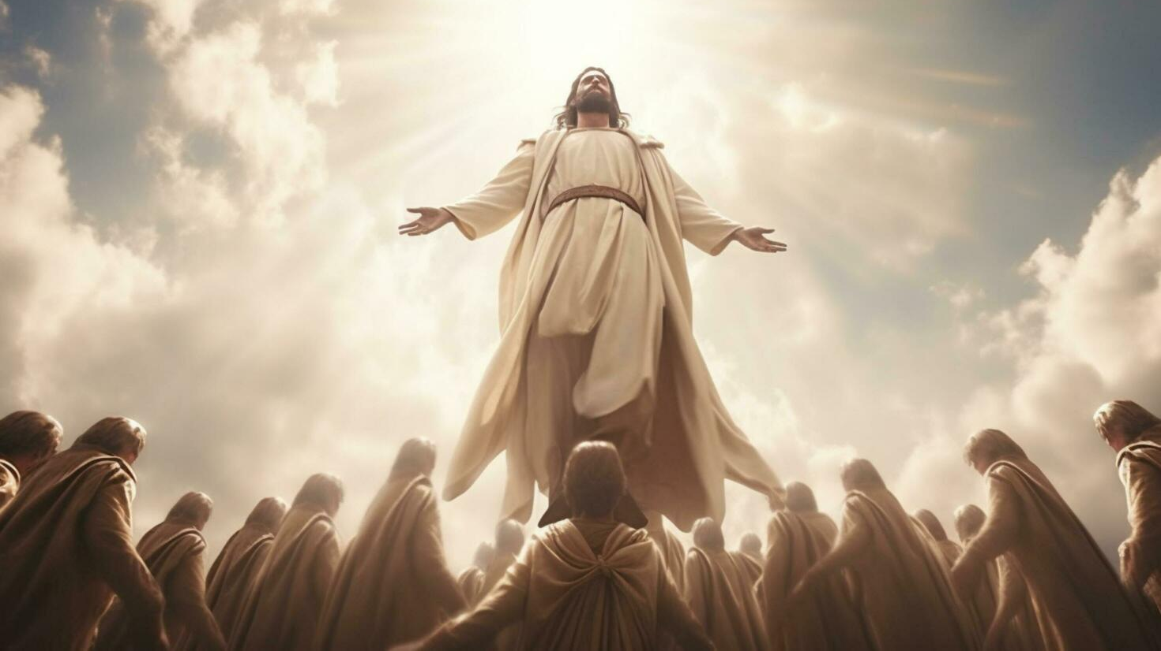
Jesus was revealed in flesh and spirit; witnessed to by angels and humans, received by earth and heaven

Slide 19
The Great Mystery
A Great Message: The scriptures are a special source of truth. (v.14)
A Great Mission: The church is a crucial bearer of the truth. (v.15)
A Great Master: Jesus IS the truth. (v.16)

Slide 20
I am an ambassador of the Kingdom of God clothed in His IMMENSE power!

